Slide 1
Wind Forecast Prediction
Team 7
Chandni Sharma
Hari Panjwani
Sanath Shetty

Slide 2
Problem Statement
48-hour ahead prediction of hourly power generation at 7 wind farms.
Given
Historical measurements
48-hour ahead predictions of wind speed and direction at the sites

Slide 3
Our Approach
Understanding the training data of 7 wind farms
Understanding the wind forecast information for each farm
Handling the zero’s in the dataset

Slide 4
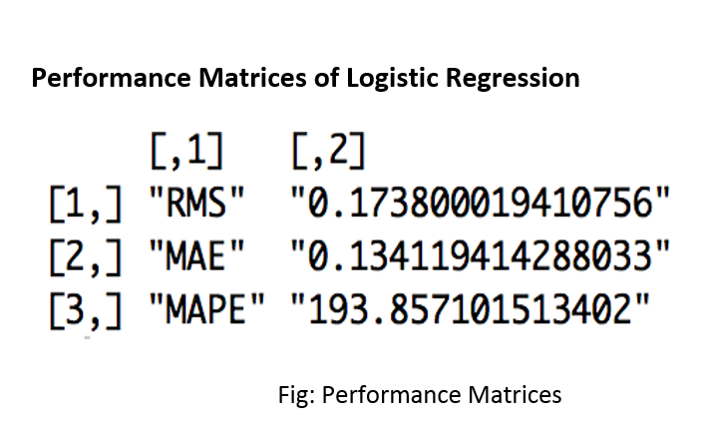
Logistic Regression

Slide 5
Decision Tree (Before Pruning)

Slide 6
Decision Tree (After Pruning)

Slide 7
Decision Tree (Performance Metrics)

Slide 8
Neural Network

Slide 9
Conclusion
Neural Network is not good, since the values are widely scattered, it took a long time to train the neural net.
We feel Regression tree would be a better because after predicting when we analyzed the predictions for wp, they were much closer and there were all positive whereas in logistic regression we had some predictive values which contained some negative value

Slide 10
Thank You !
Any Questions?

